Slide 1

Fifth Annual General Meeting
Allard Homeowners Association
October 22, 2025
Notes:
2 min
>>>> Add website address
>>>> Add map
https://docs.google.com/spreadsheets/d/1DOFr4uCRdyw71XIuOE1jQc0TIeO6Owehy0YQyuej9l8/edit?usp=gmail
https://docs.google.com/spreadsheets/d/1DOFr4uCRdyw71XIuOE1jQc0TIeO6Owehy0YQyuej9l8/edit?usp=gmail
https://docs.google.com/spreadsheets/d/1DOFr4uCRdyw71XIuOE1jQc0TIeO6Owehy0YQyuej9l8/edit#gid=546921390
https://docs.google.com/document/d/1CpqDUSeUYz9WFMCk66s0hEsDaUTYR5LFtKMJj9hmXZQ/edit

Slide 2

AGENDA
Opening - Call to Order
Introduction of Current Board Members
Appointment of Recording Secretary and Presiding Member
Registration of Attendance
Confirmation of quorum (10 or more persons entitled to collectively cast 10 or more votes)
Annual Report (review and discuss the audited financial report)
Q&A related to Financial Report
Landscaping updates
Q&A related to Landscaping
Appoint the auditors or accountants of the Association for the ensuing year
11. Election of the Board of Directors:
  President:
  Vice-President:
  Secretary:
  Treasurer:
  Director x3
Note the Board must contain a minimum of 3, and a maximum of 7 members.
13. Further business, if any
14. Conclusion / Adjournment.
Notes:
2min
Introduction (Jon)
Call to order and appointment of recording secretary (Chris)
Report of Interim Board (Chris)

Slide 3
The Board Member Presides
call the meeting to order
Notes:
6min

Slide 4
Introduction of Current Members
President: Vacant
Vice President: Vipin Yadav
Treasurer: Gunjan Vyas
Secretary: Vacant
Director: Shaikh Hussain
Director: Janak Patel
Director: Vacant
Notes:
6min

Slide 5
Appointment of Recording Secretary and Scrutineer
Janak Patel to act as Scrutineer for the Meeting
Michelle Antonyshyn to act as Recording Secretary
Notes:
15min – (1-2 min per board member) + 2min tro
4 - Election of Directors
Board members
Overall board structure
1 slide per person

Slide 6
Scrutineer’s Report on Attendance
Record attendance
Confirmation of quorum (10 or more persons entitled to collectively cast 10 or more votes)
Notes:
15min – (1-2 min per board member) + 2min tro
4 - Election of Directors
Board members
Overall board structure
1 slide per person

Slide 7
Financial Statements (Review and discuss audited report)
Rutwind Brar LLP. – Cory Laforest
Notes:
15min – (1-2 min per board member) + 2min tro
4 - Election of Directors
Board members
Overall board structure
1 slide per person

Slide 8
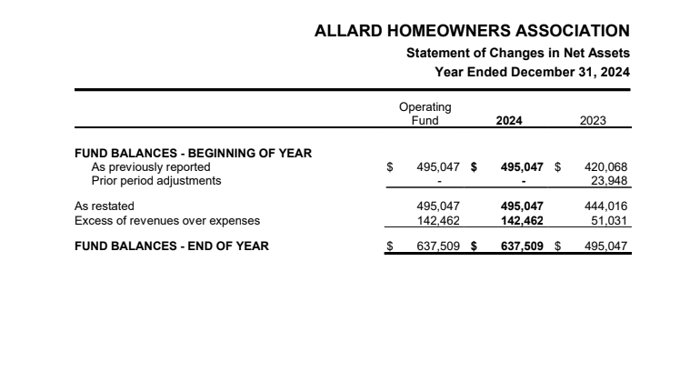
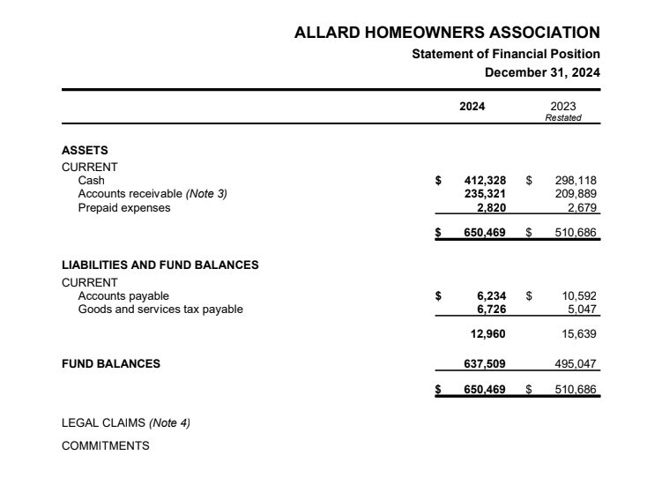
2024 Financial Statements
Notes:
5 min
Financial – TBC
Can we actually change the current financial slide to high level expenses breakdown and show the community how their HOA fee is being calculated?
Just a thought, because the community should have over 1000 houses and they would want to know why do they need to pay that much and how much did they actually get spent.
~Flora

Slide 9
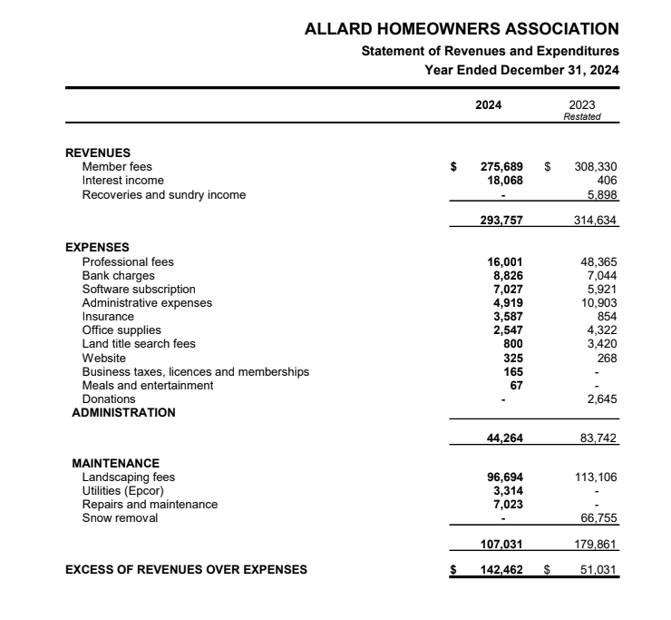
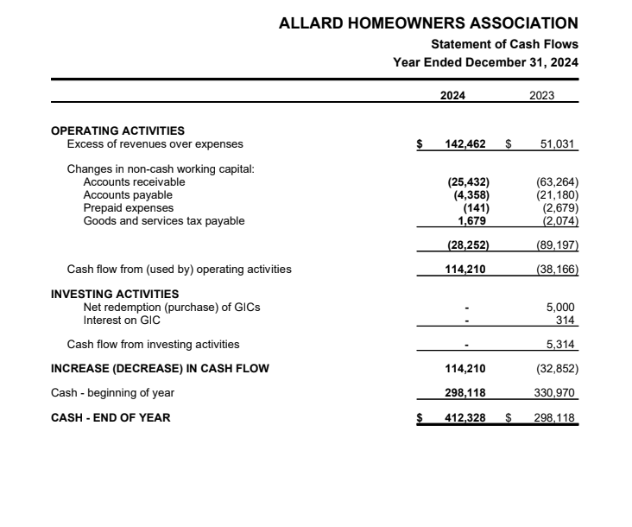
2024 Financial Statements
Notes:
5 min
Financial – TBC
Can we actually change the current financial slide to high level expenses breakdown and show the community how their HOA fee is being calculated?
Just a thought, because the community should have over 1000 houses and they would want to know why do they need to pay that much and how much did they actually get spent.
~Flora

Slide 10
Discussion of the Financial Report
Q & A

Slide 11
Motion to Approve Financial Report

Slide 12
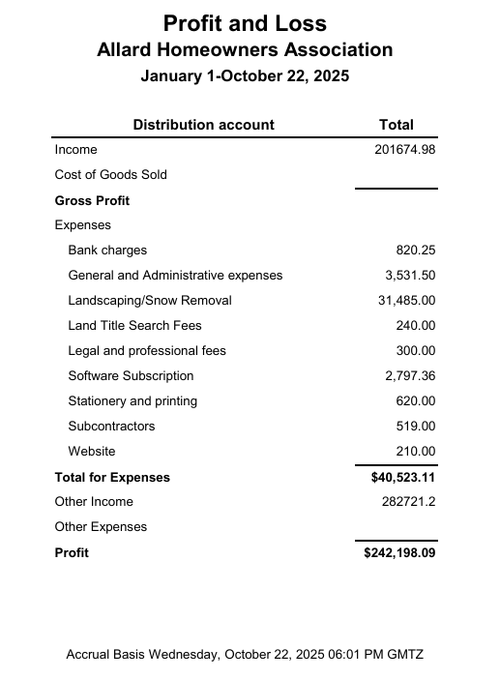
2025 Year to Date Statement
Notes:
5 min
Financial – TBC
Can we actually change the current financial slide to high level expenses breakdown and show the community how their HOA fee is being calculated?
Just a thought, because the community should have over 1000 houses and they would want to know why do they need to pay that much and how much did they actually get spent.
~Flora

Slide 13
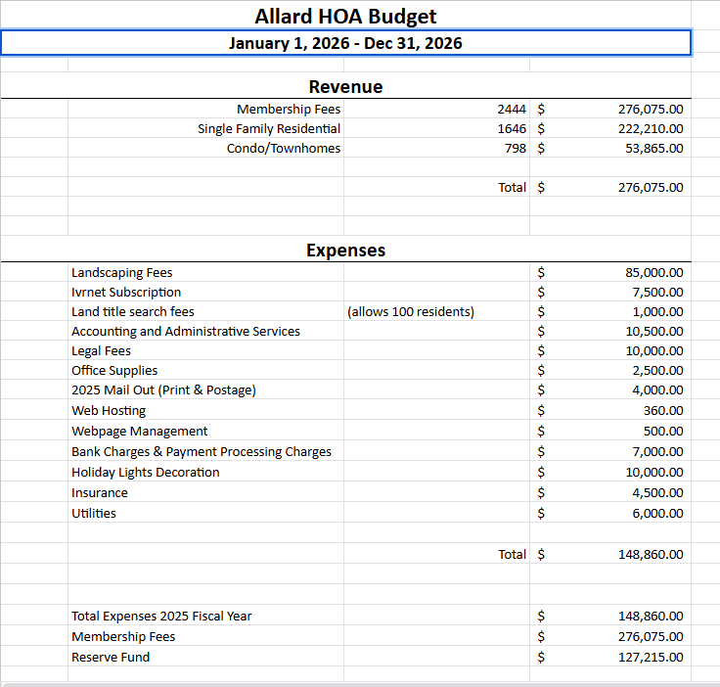
2025 Budget
Notes:
5 min
Financial – TBC
Can we actually change the current financial slide to high level expenses breakdown and show the community how their HOA fee is being calculated?
Just a thought, because the community should have over 1000 houses and they would want to know why do they need to pay that much and how much did they actually get spent.
~Flora

Slide 14
Q & A

Slide 15
Summer Landscaping

Slide 16
Landscaping Update 2024
- Flower beds: (Not just an ordinary job of slapping flowers)
1st row of amur maples (pruned to bonzi time to time), second row of limelight hydrangeas (flowers), third layer of Carl rosenfield double red peonies (flowers), the fourth is a layer of sea daylily (flowers), the last fifth layer of annual flowers curated and positioned very thoughtfully.
- Creating large garden style beds with top soil, douglas fir mulch, and edging (June 2024)
- Getting the traffic control lawn sings across the community
- Removal of marketing lawn signs every single day to make community look clean and tidy.
- Hauling a huge load of mulch and filling up the tree-lined median island at the entrance on James Mowatt

Slide 17
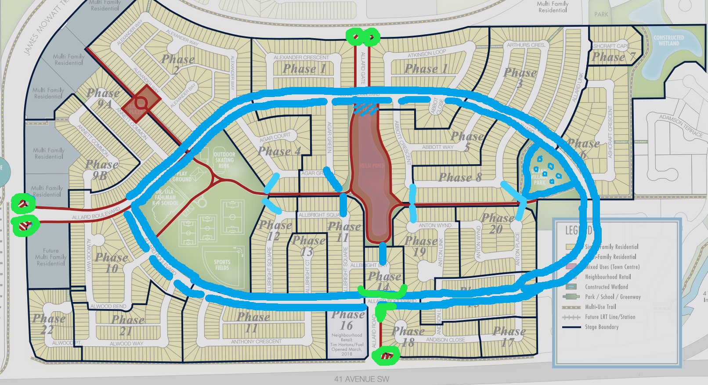
What did we change in 2024?

Slide 18
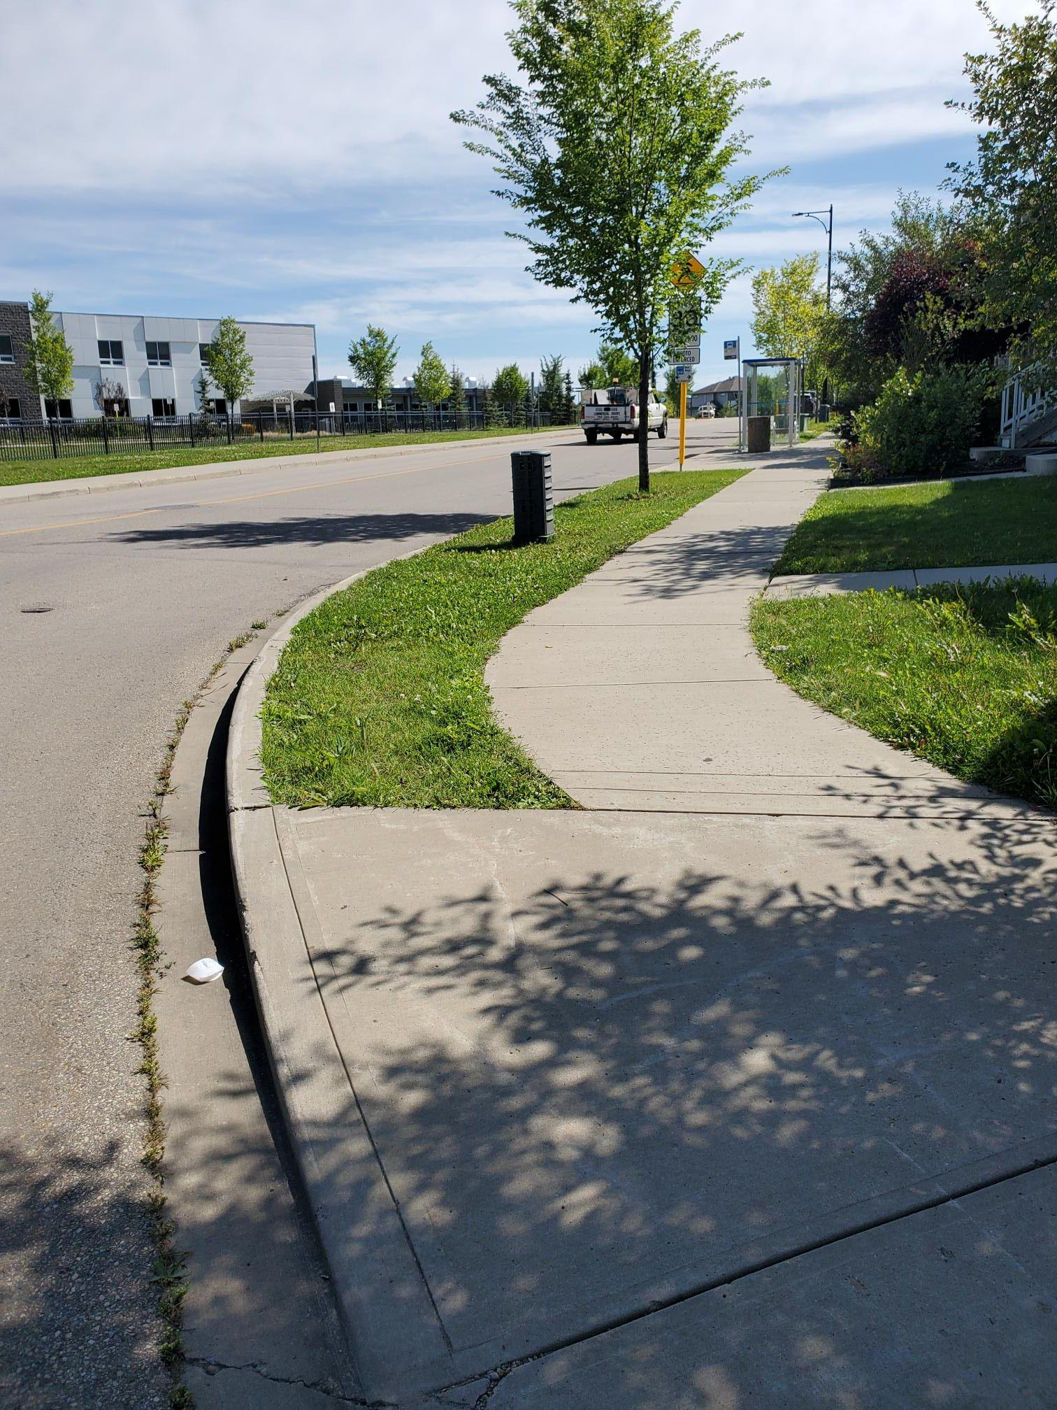
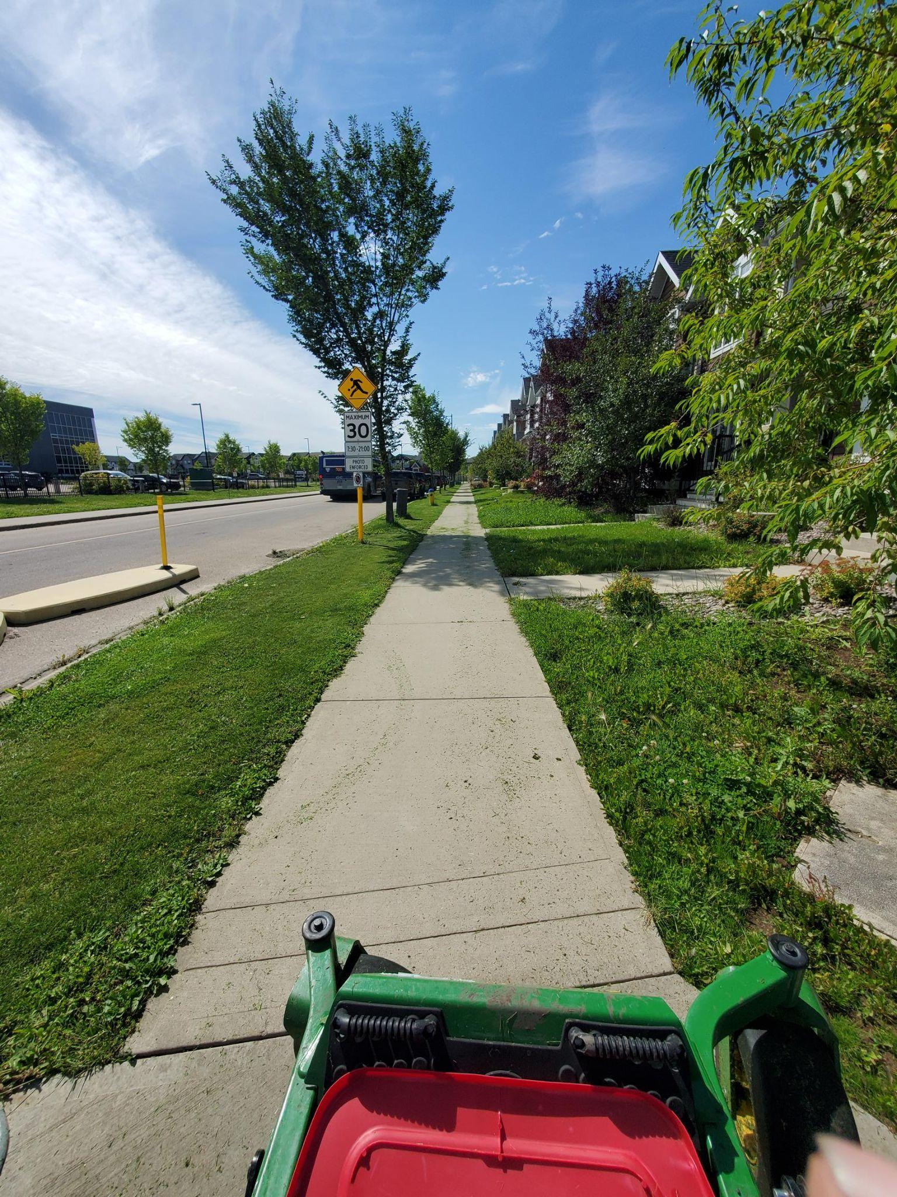
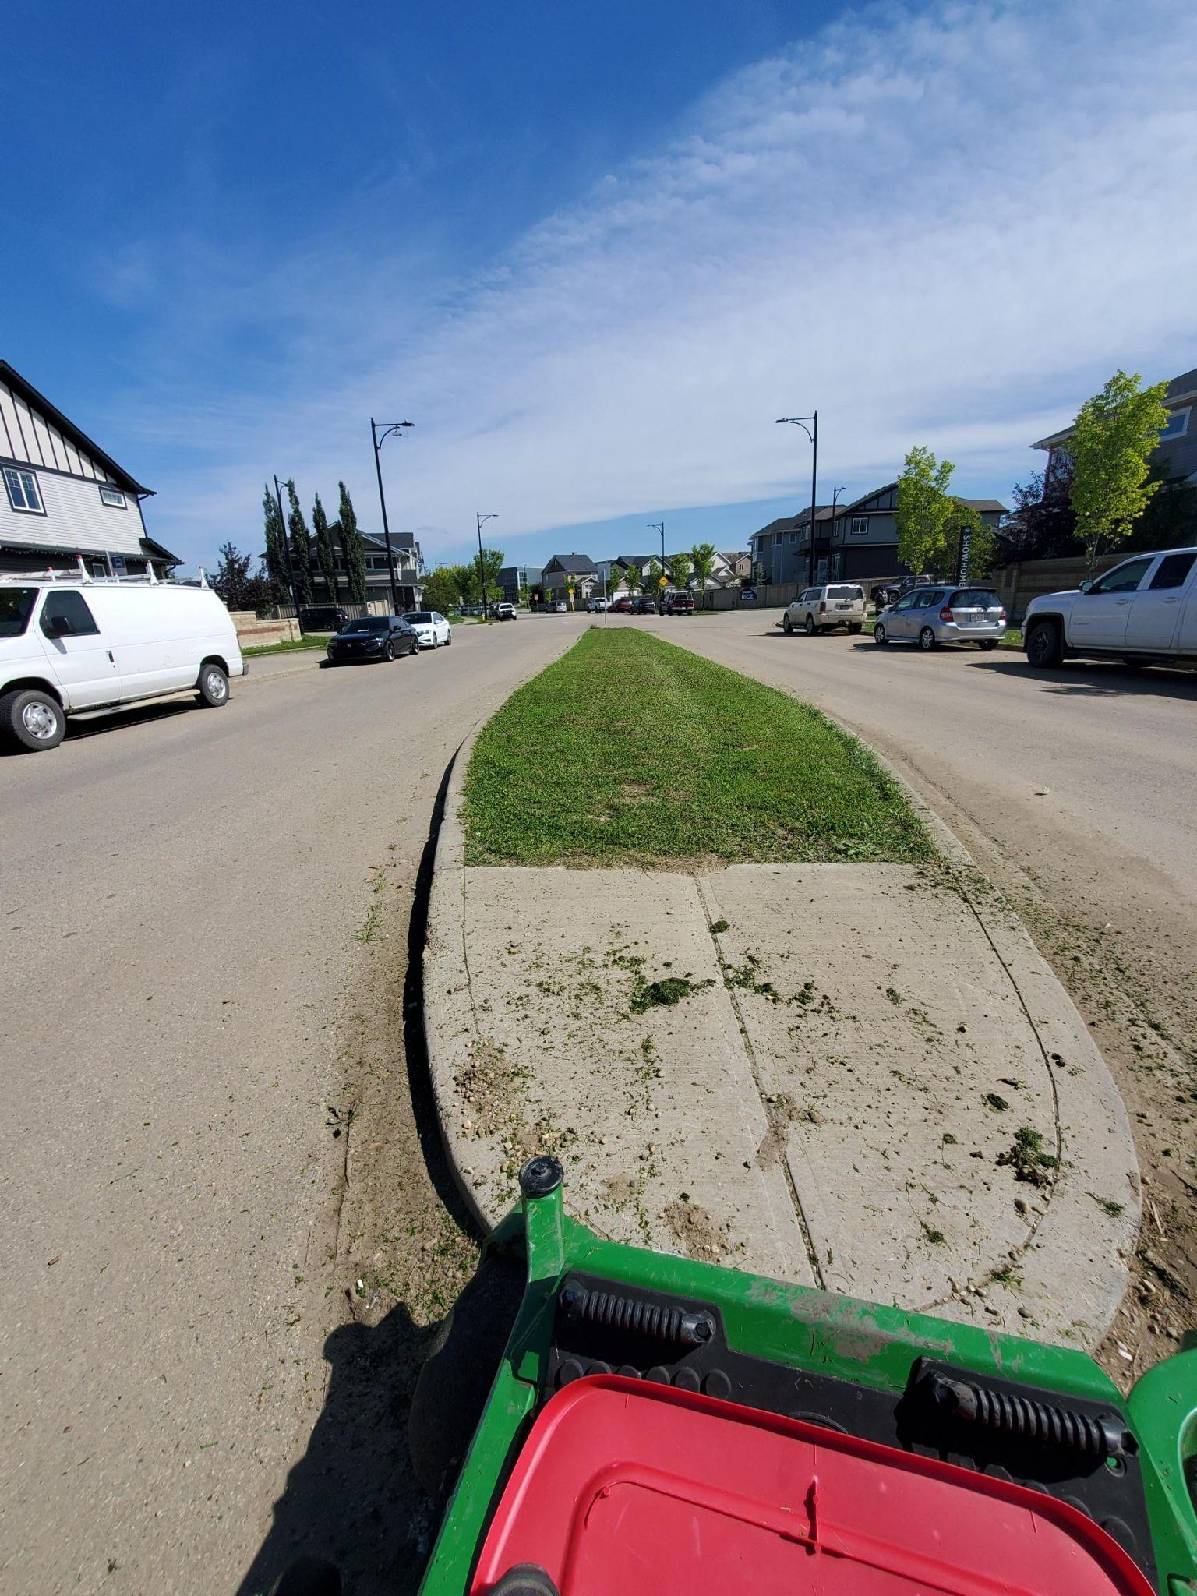
Summer 2025

Slide 19
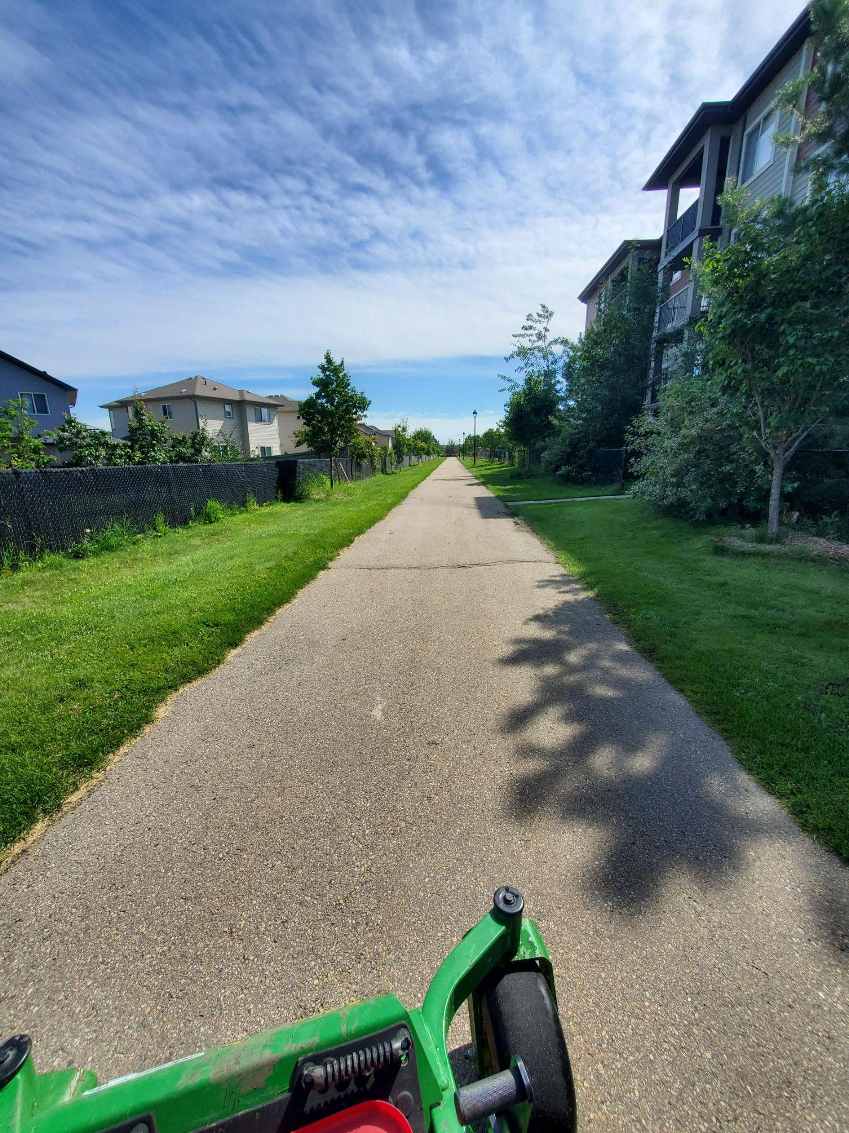
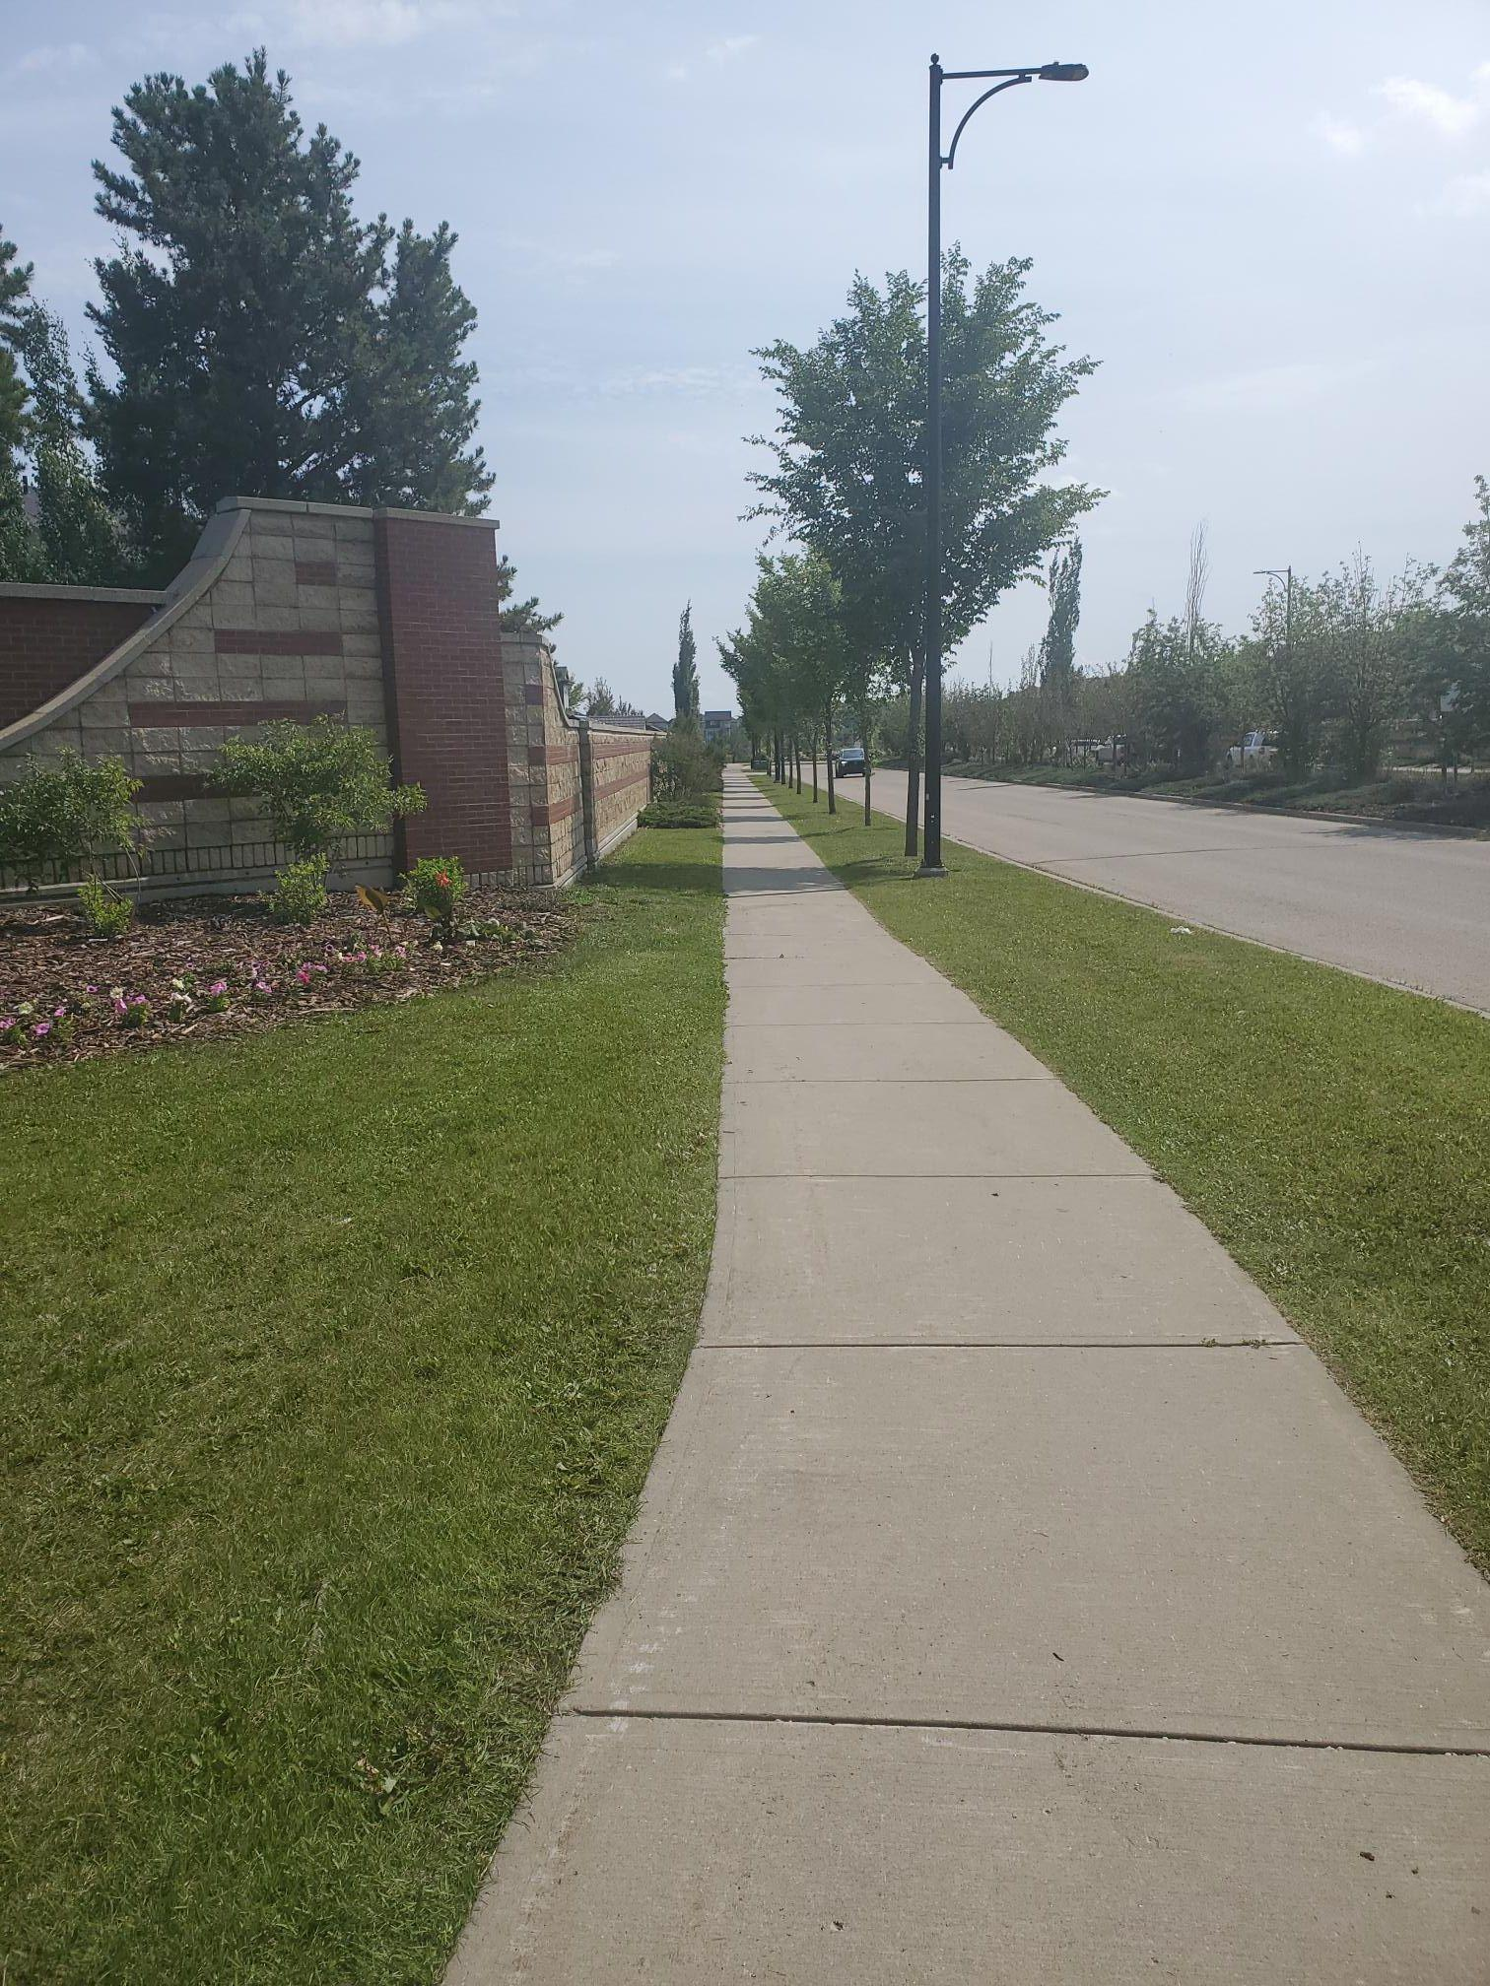
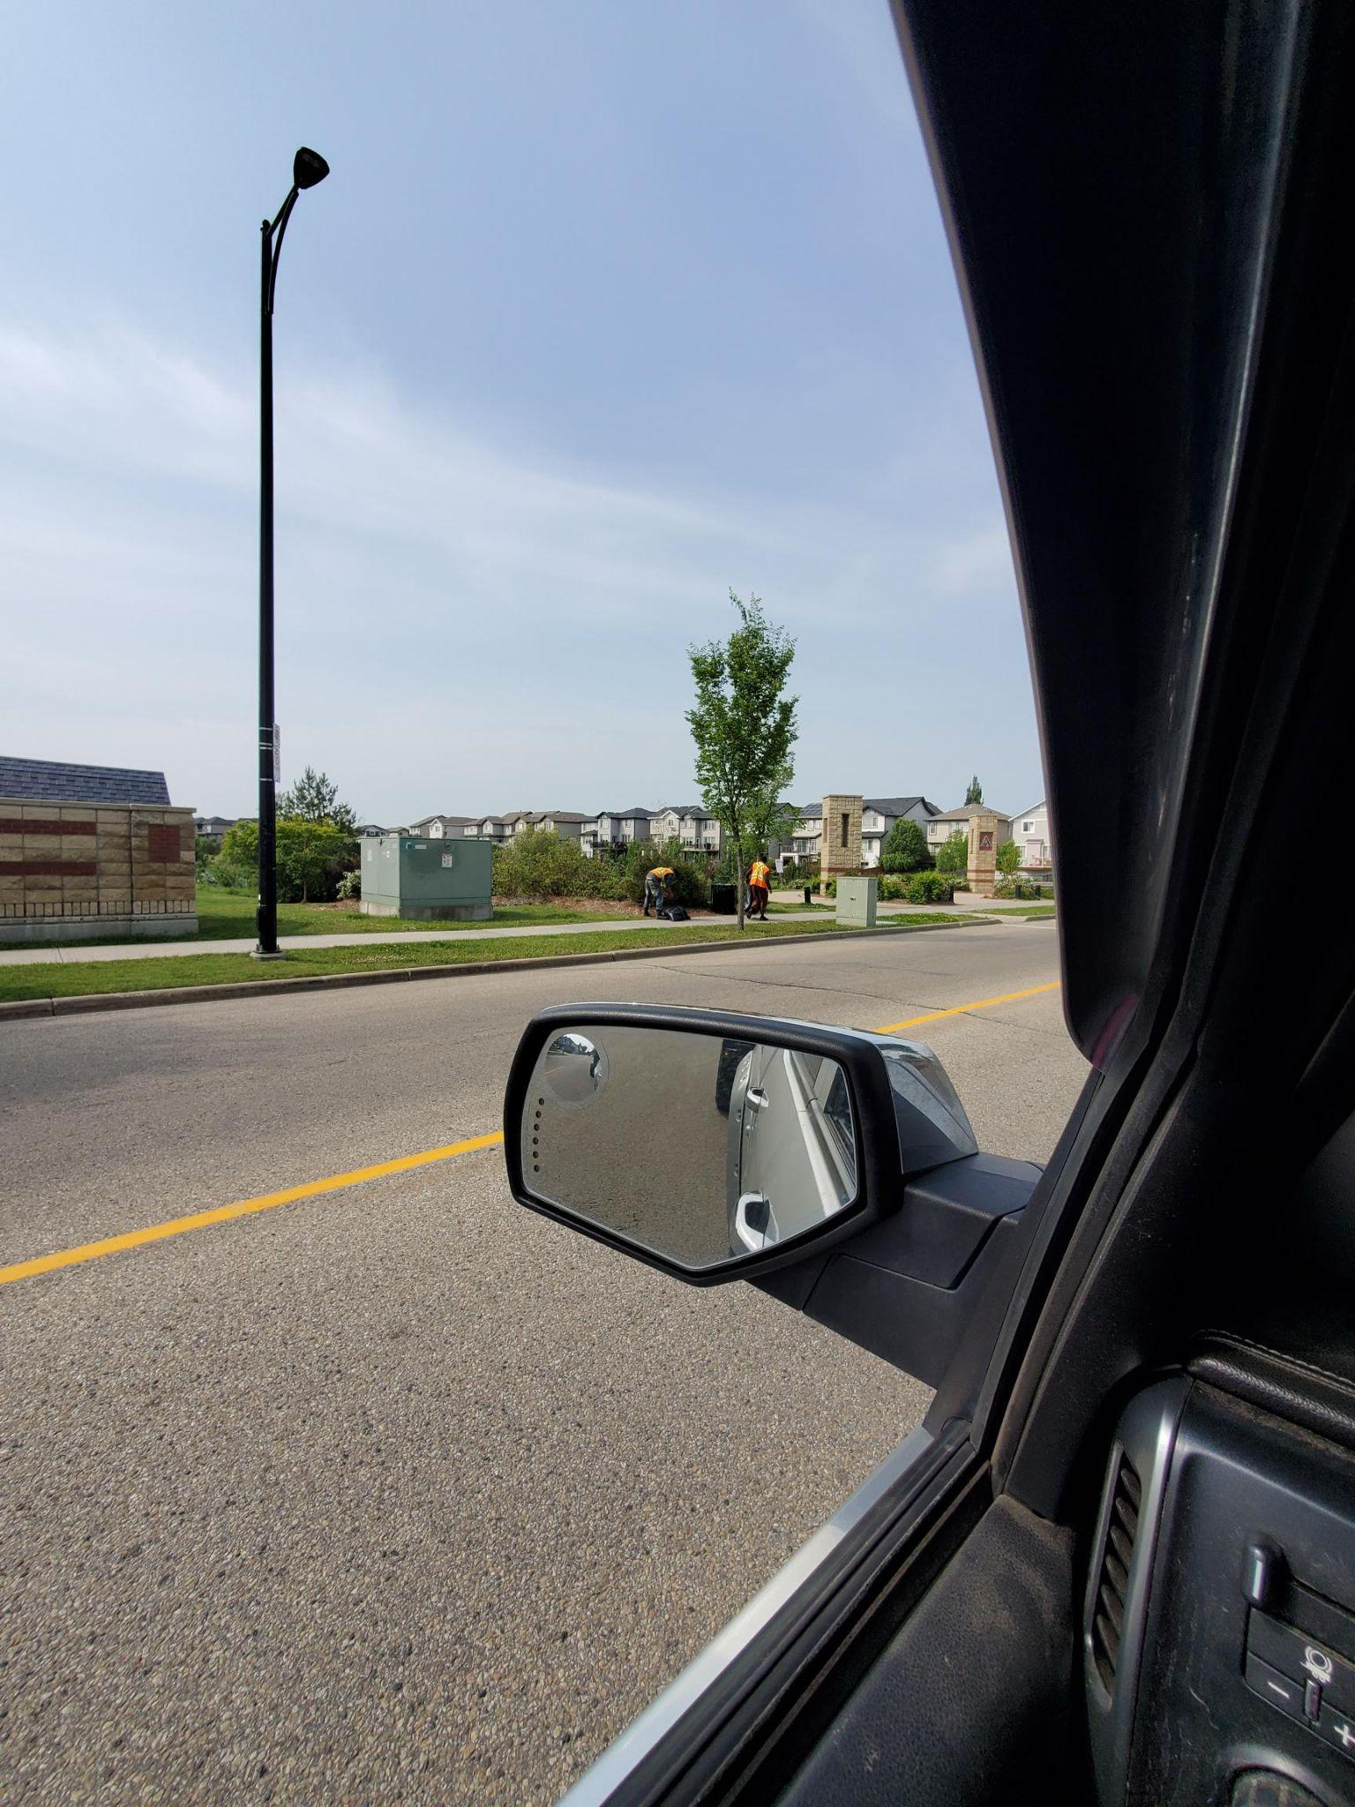
Walking Trails through the Parks and Ponds

Slide 20
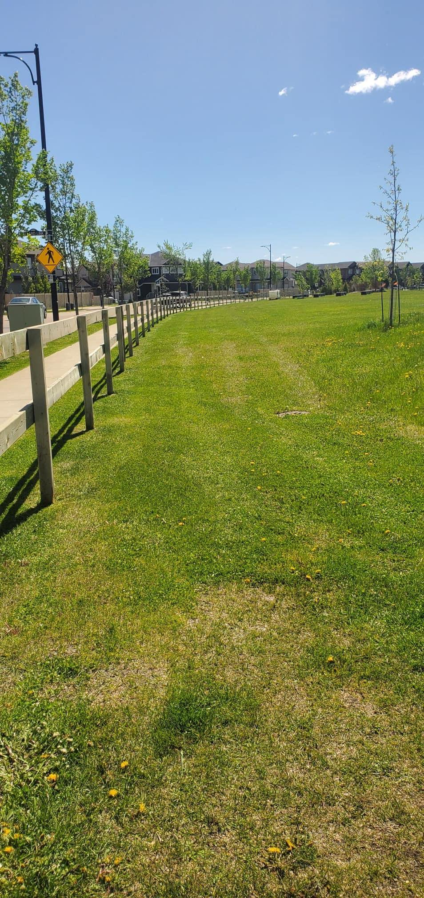
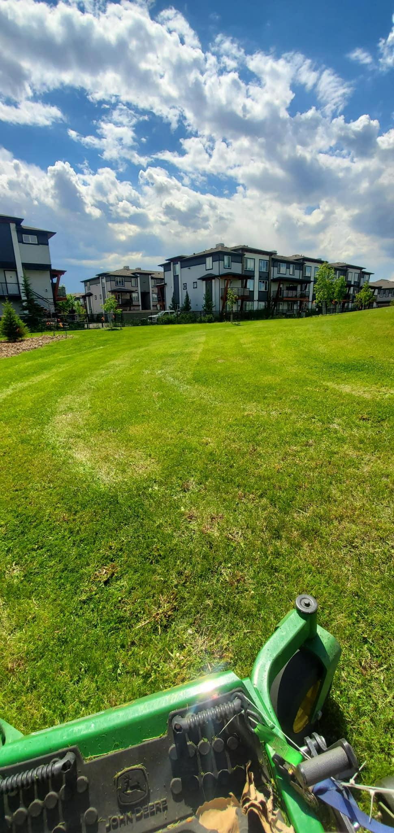
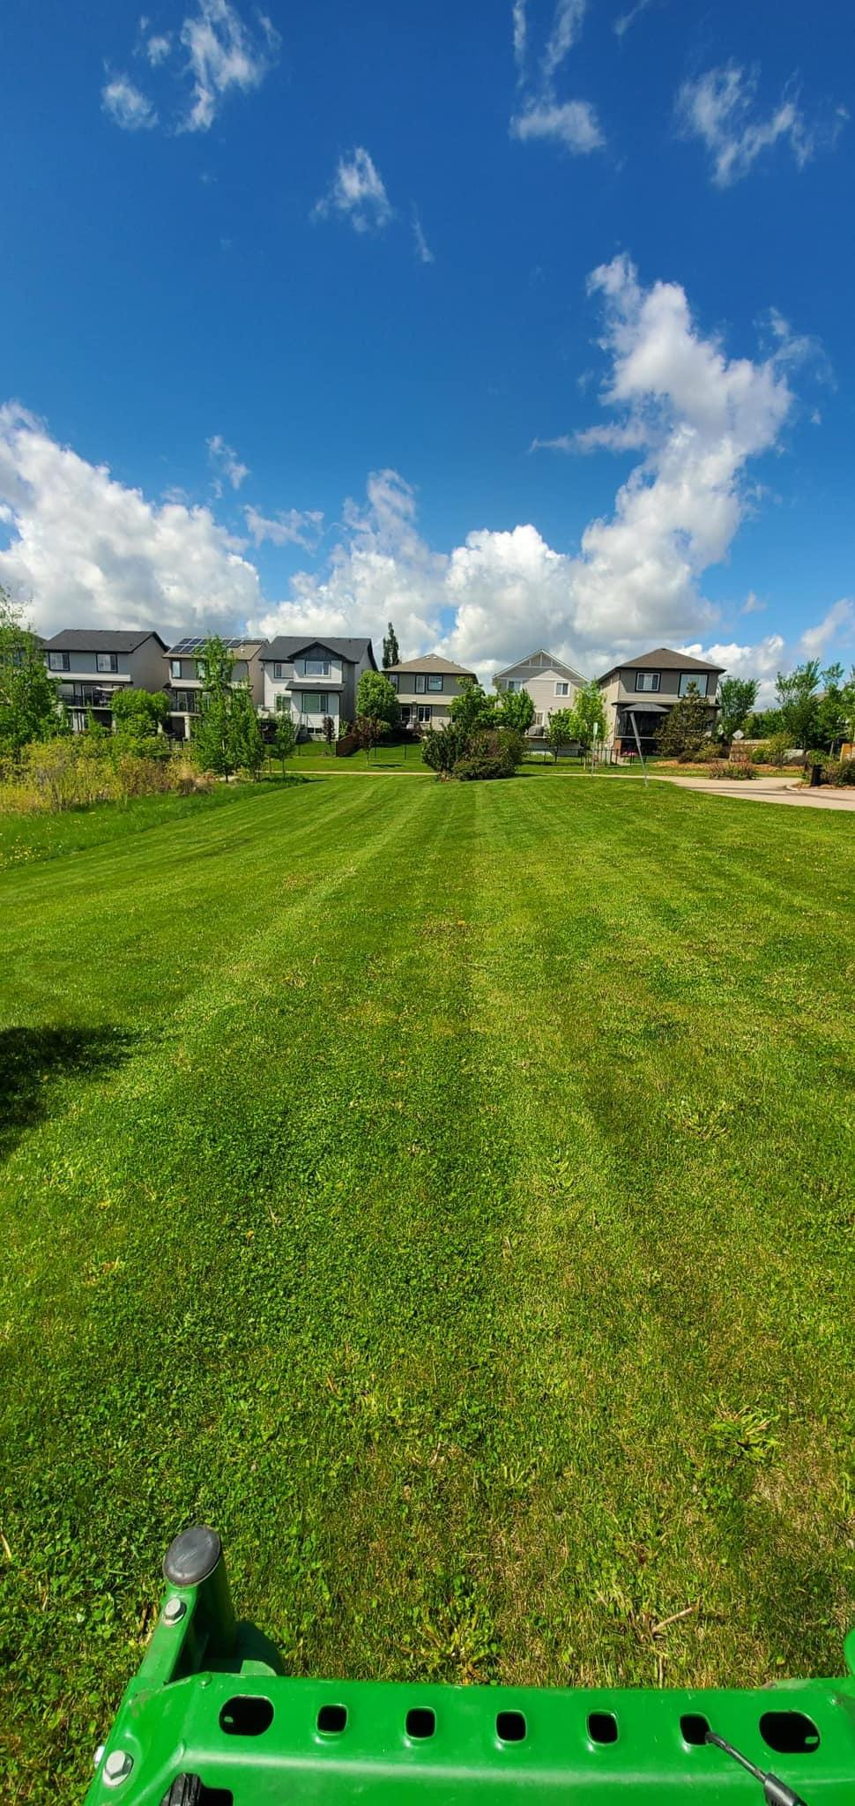
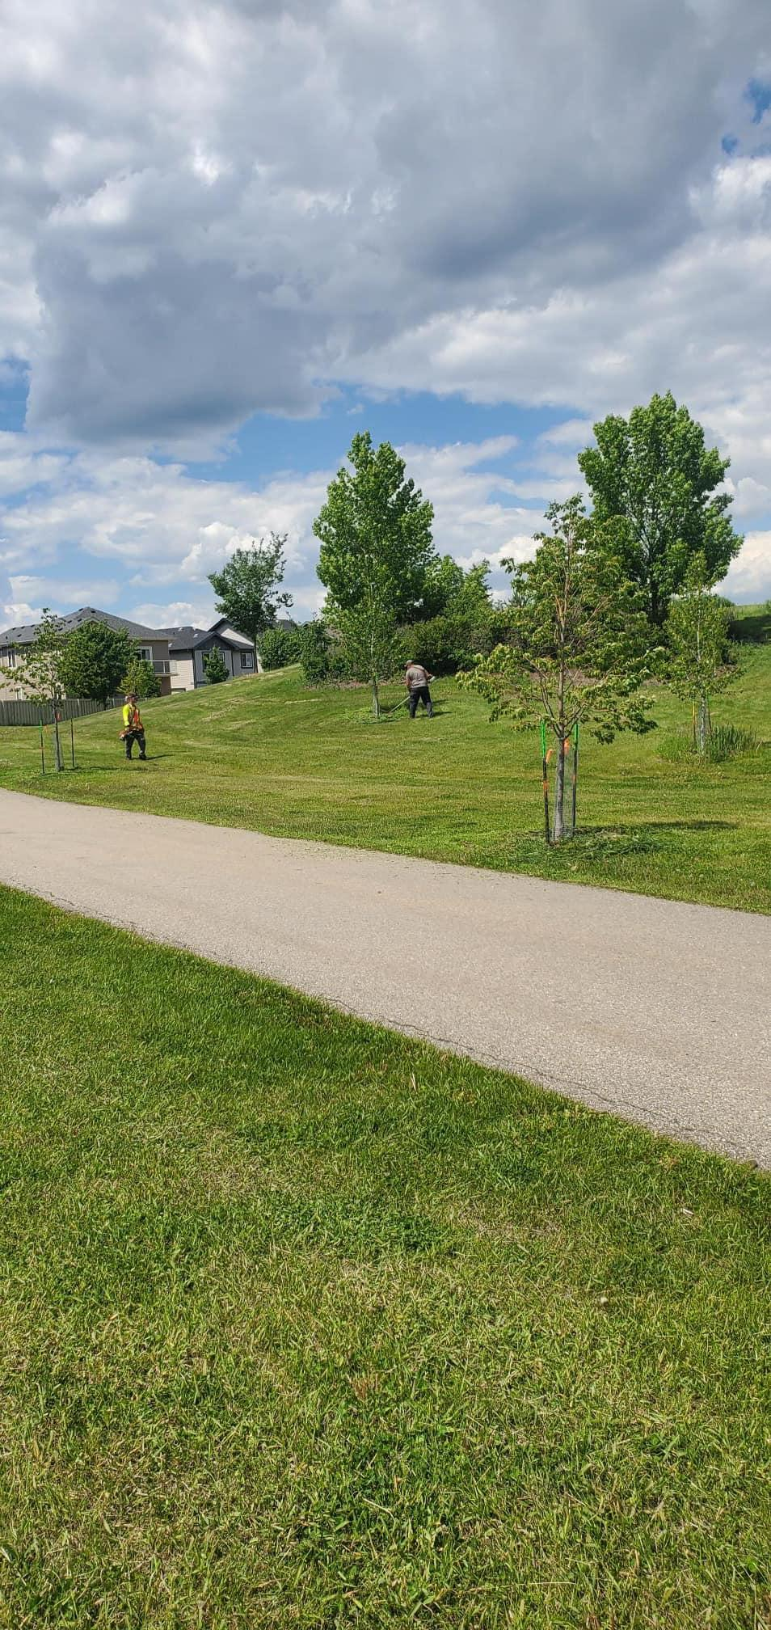
Parks

Slide 21
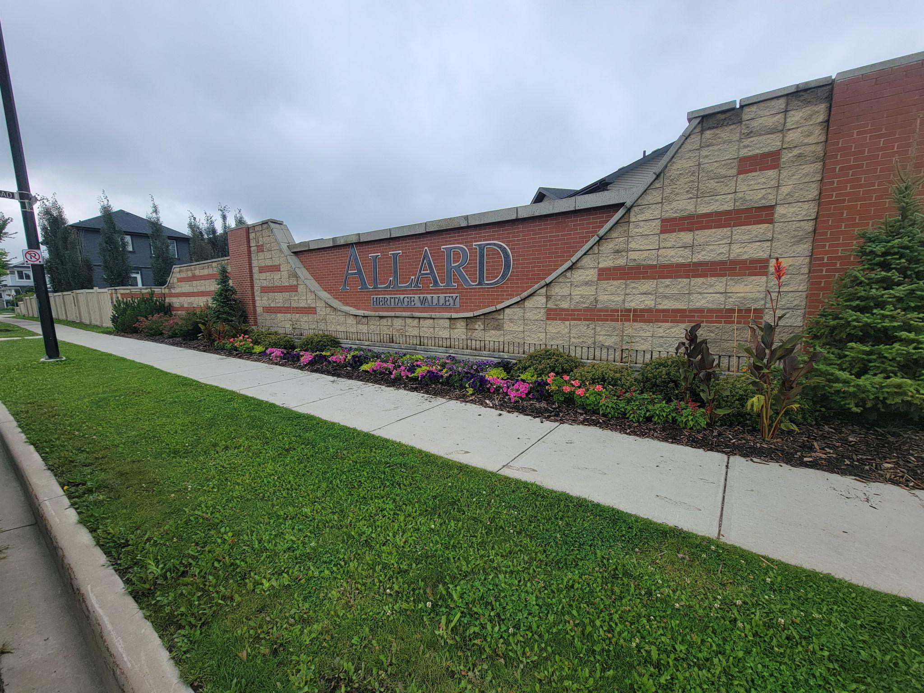
Entrances

Slide 22
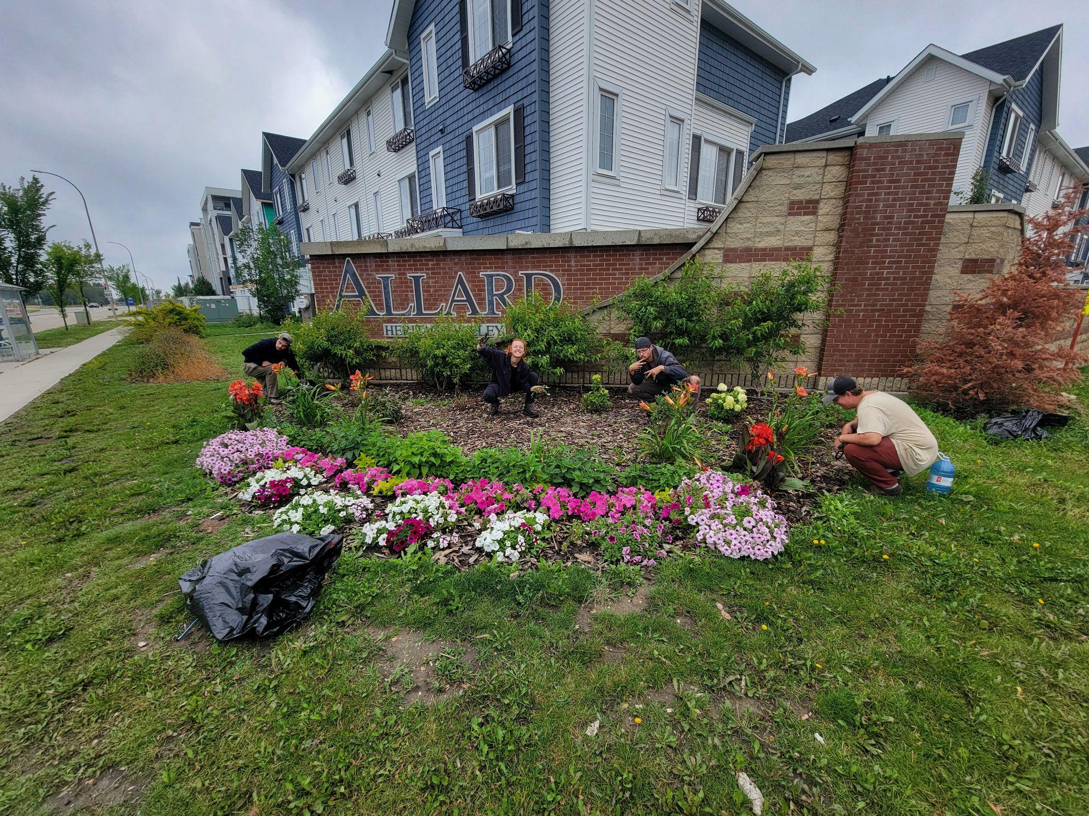
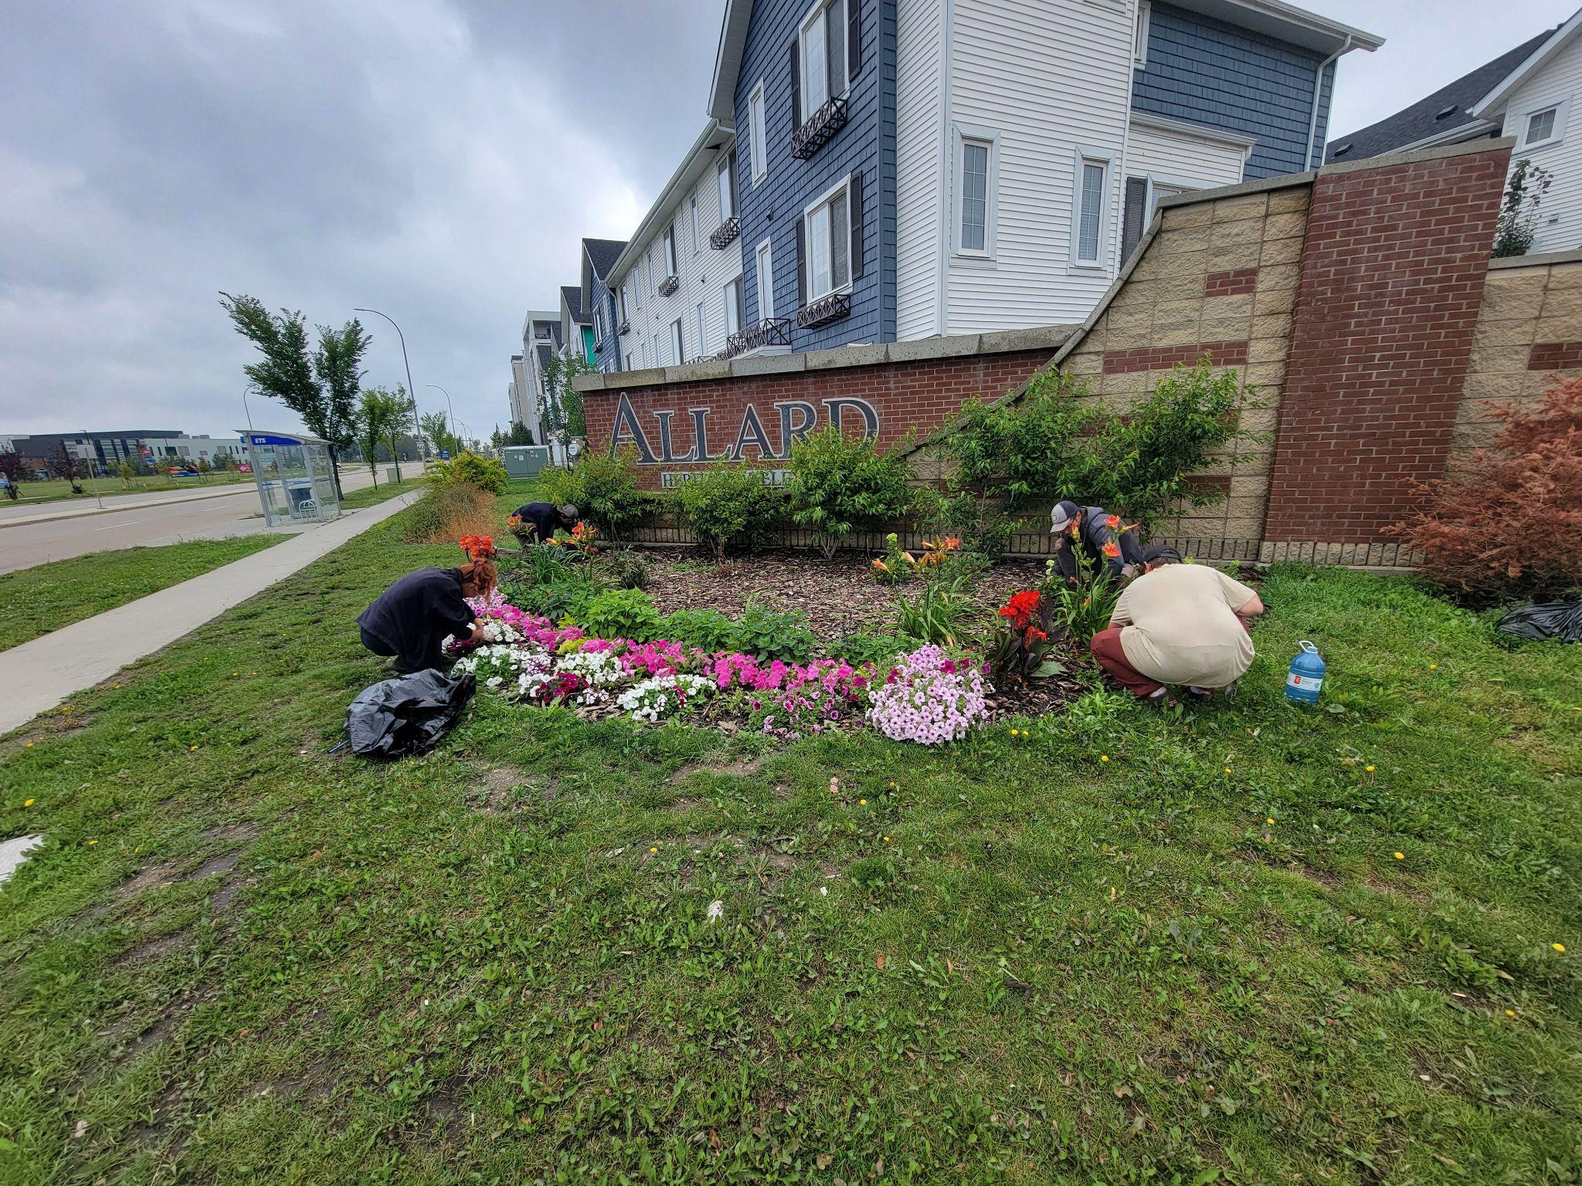

Slide 23
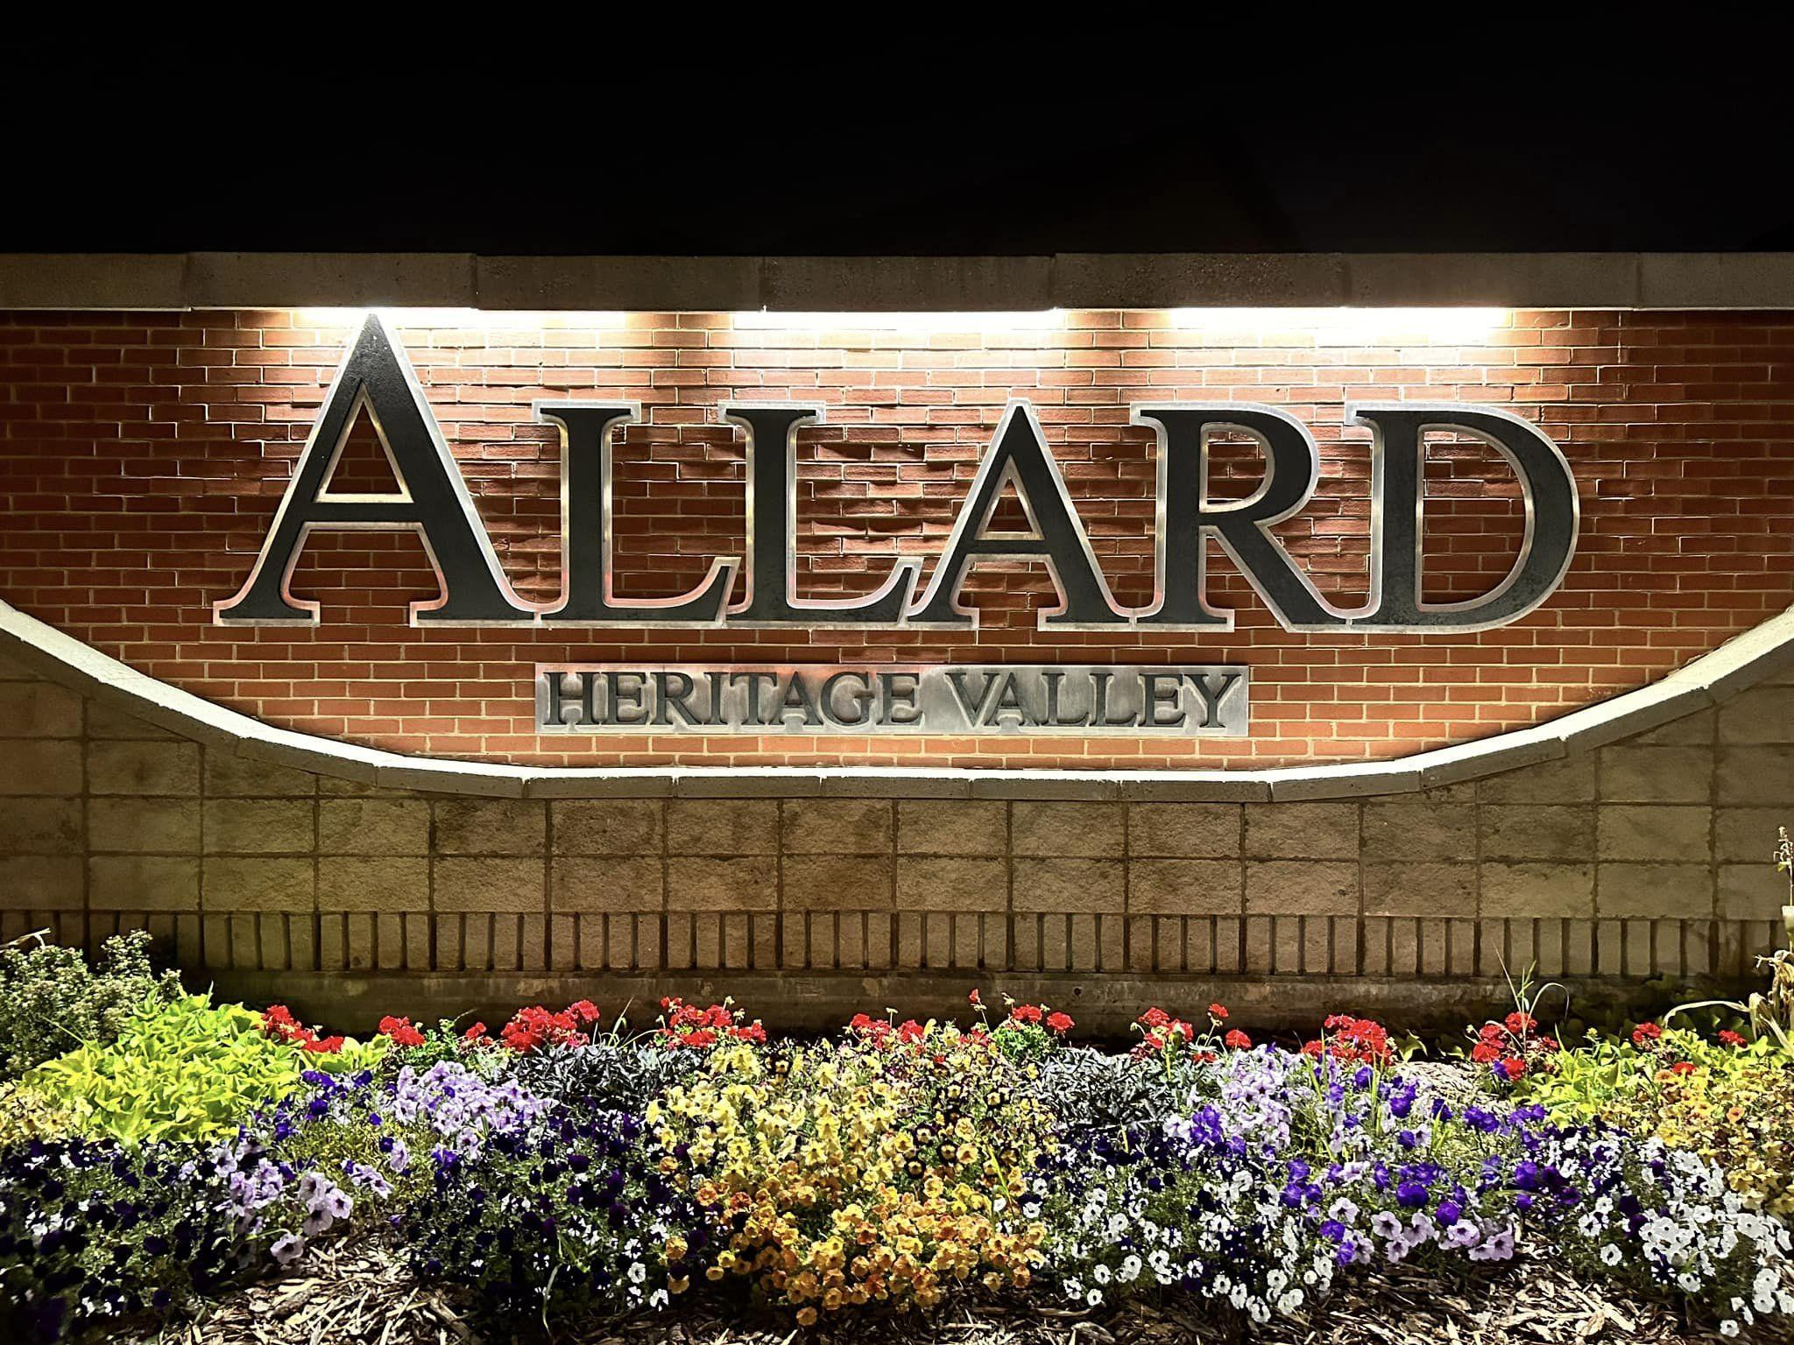

Slide 24
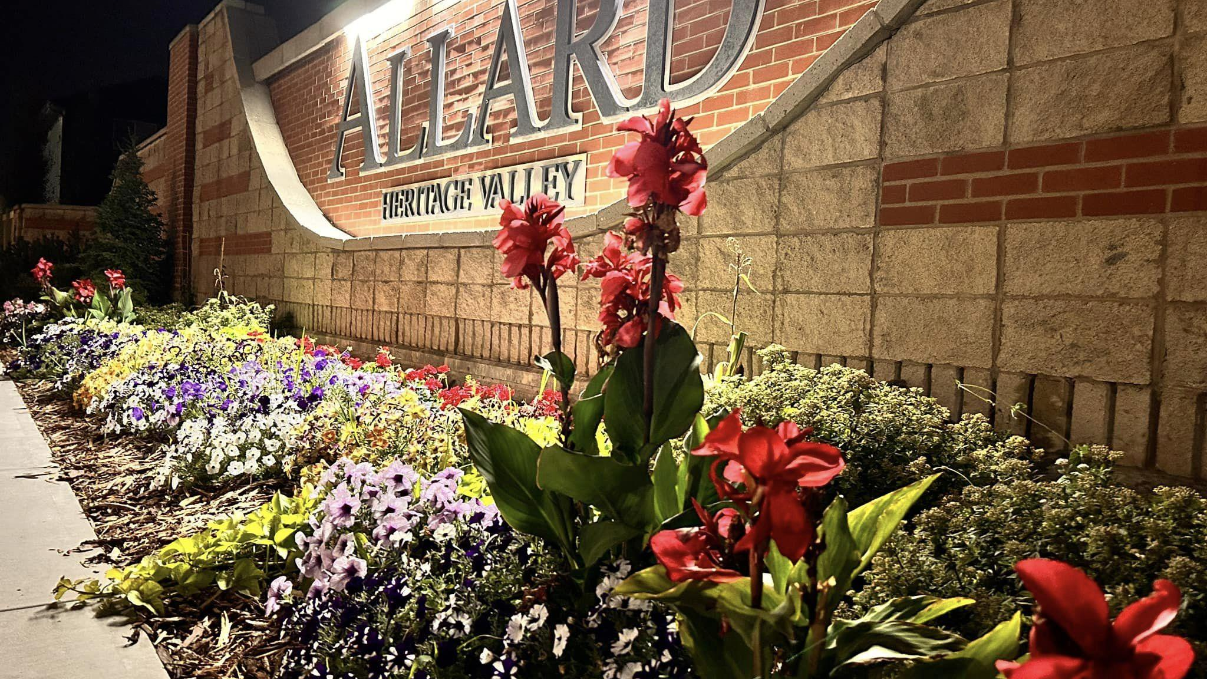

Slide 25
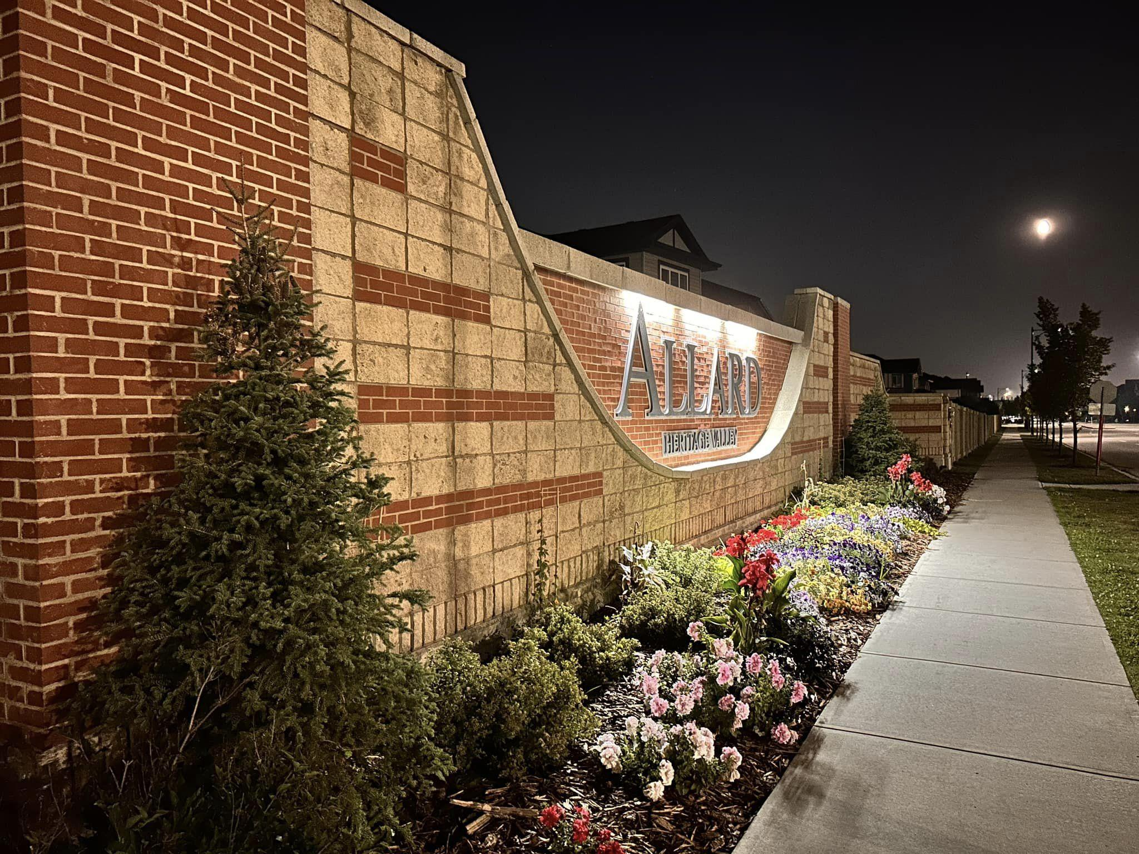
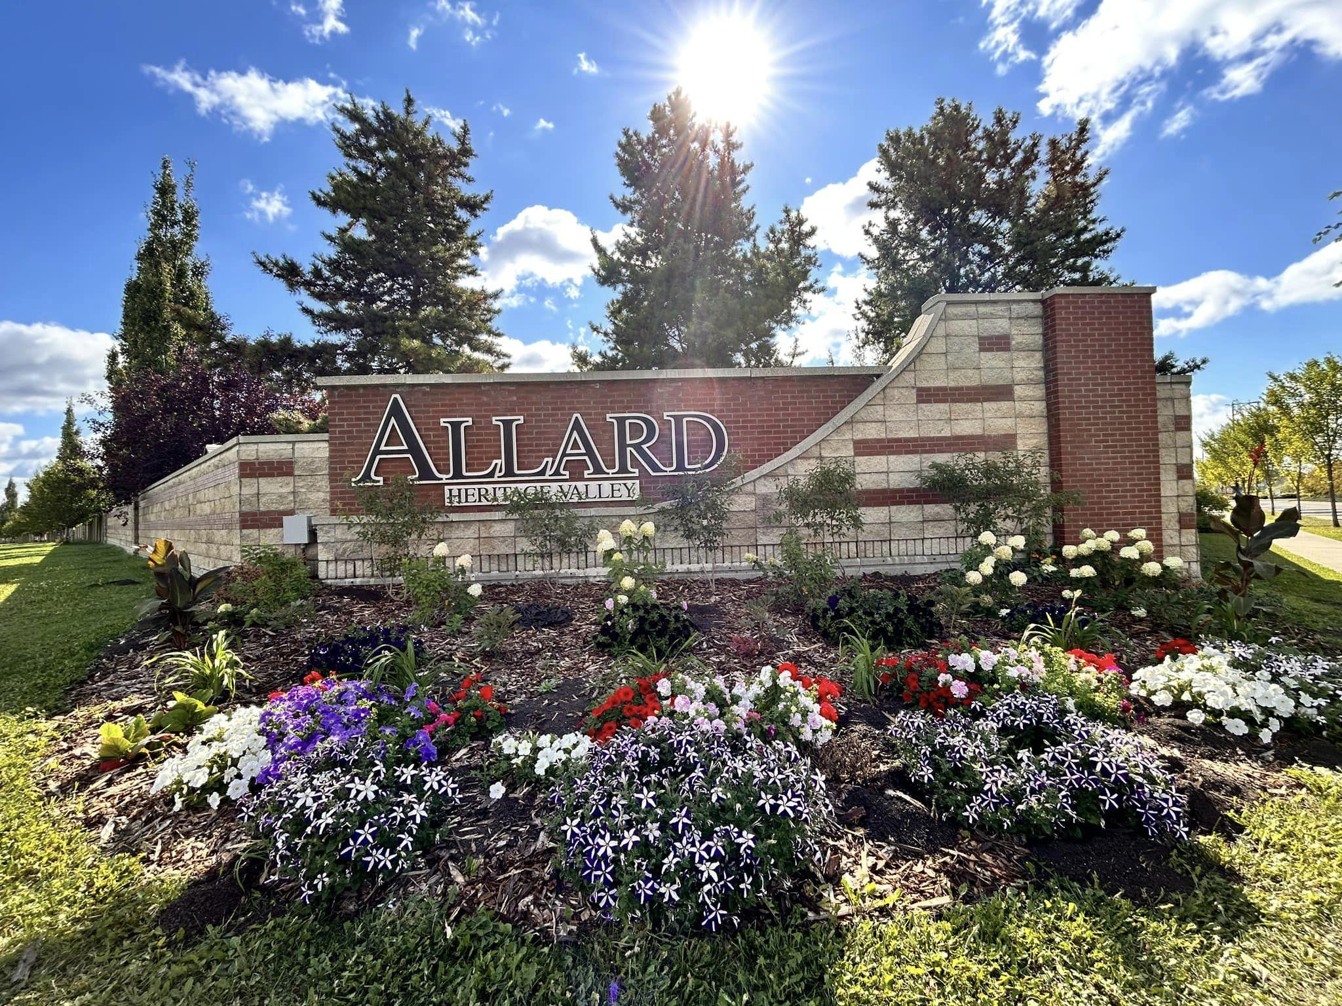
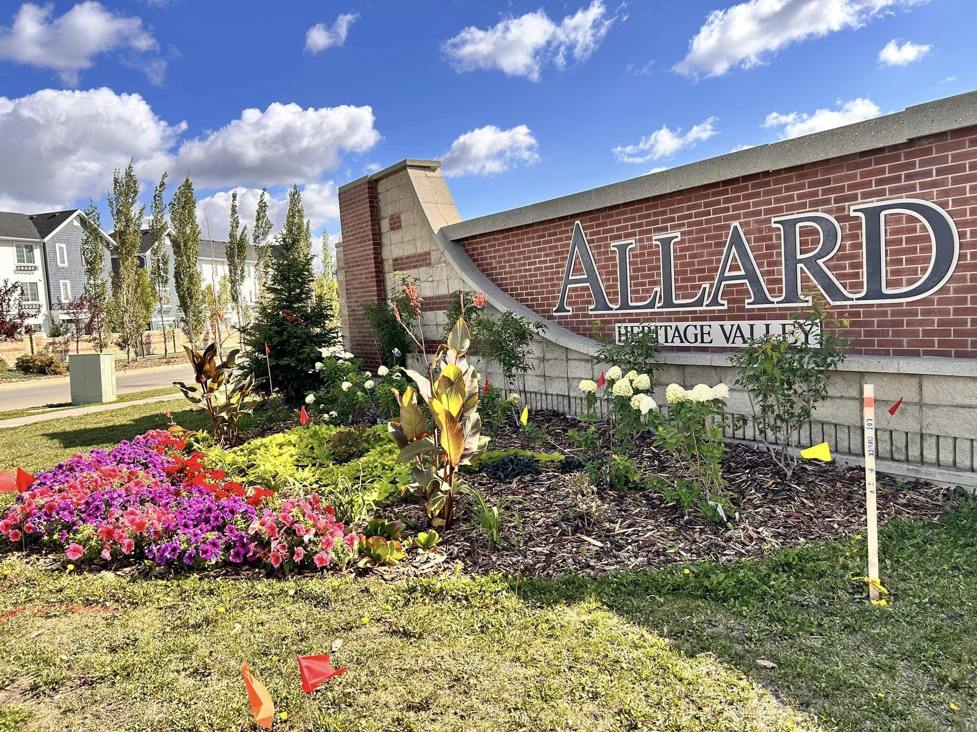

Slide 26
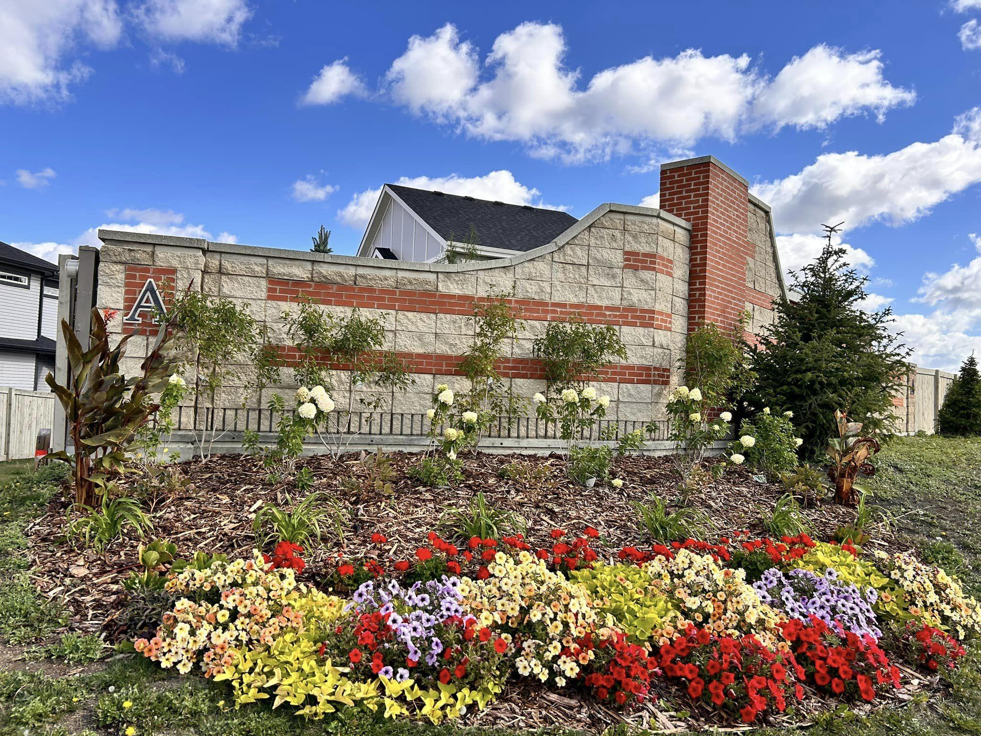
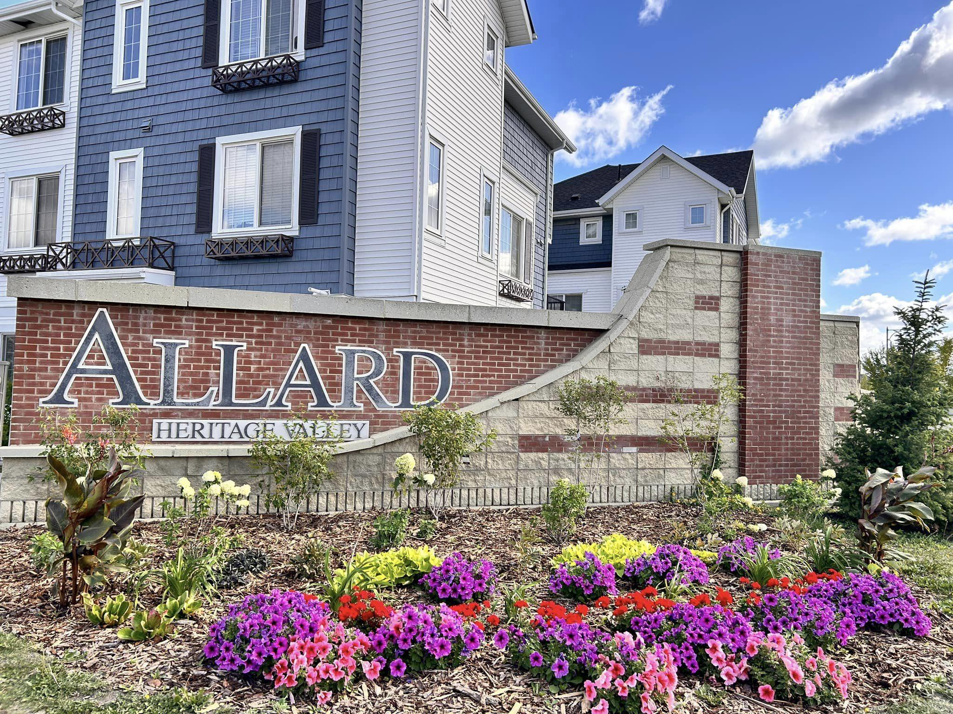
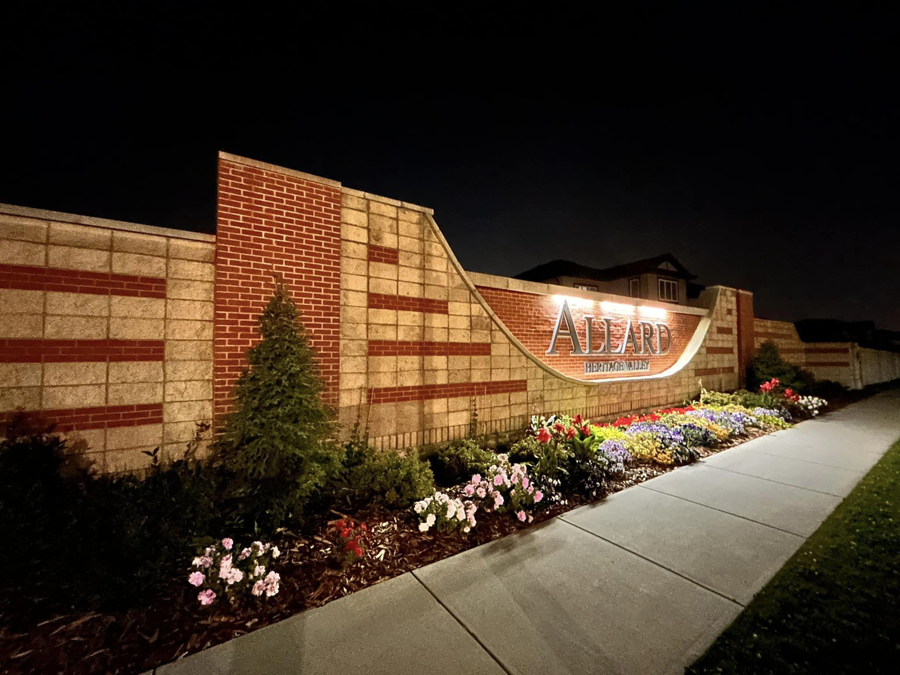

Slide 27
Q & A

Slide 28
Future Plans
Implementation of transaction fees for Credit Card Payments
Create a pool of savings (GIC) to support big maintenance items
Holiday lights during winter times
Proposed budget every year
Support the volunteer teams, i.e., Neighborhood Watch groups
Flowerbeds every year
Making the rational and optimum use of the HOA Fees
Enhances entrances
Creating stronger communication channels between the HOA and the residents

Slide 29
Motion to Appoint the Auditors or Accountants
Rutwind Brar LLP

Slide 30
Election for the Board members

Slide 31
Election of Directors
Fixing the number of positions on the Board of Directors
Election of Directors – only members in good standing may be nominated
President
Director
Vice-President
Board of Directors
Director
Secretary
Director
Treasurer

Slide 32
Motion for Election of Board Members:
Maximum 7 members on the board, as per the bylaw
Current Nominations
Inviting nominations
Motion to elect the nominated members

Slide 33
Further Business, if any.

Slide 34
Meeting Adjourned

Slide 35
Notes

Slide 36
Annual General Meeting
Wednesday October 22, 2025
Time : 7:00 pm
Address: Dr. Lila Fahlman School (Gymnasium)
680 Allard Boulevard, Edmonton, AB
***Please note that only members with no outstanding HOA Fees are eligible to vote.***
Contact: info@allardhoa.com
Notes:
6min

